Slide 1
Week #1:
In-class set-up

Slide 2
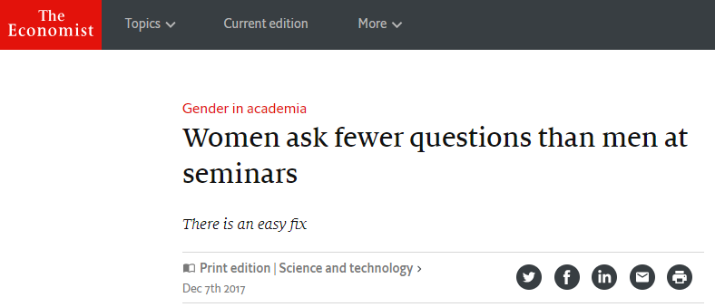
A case study

Slide 3
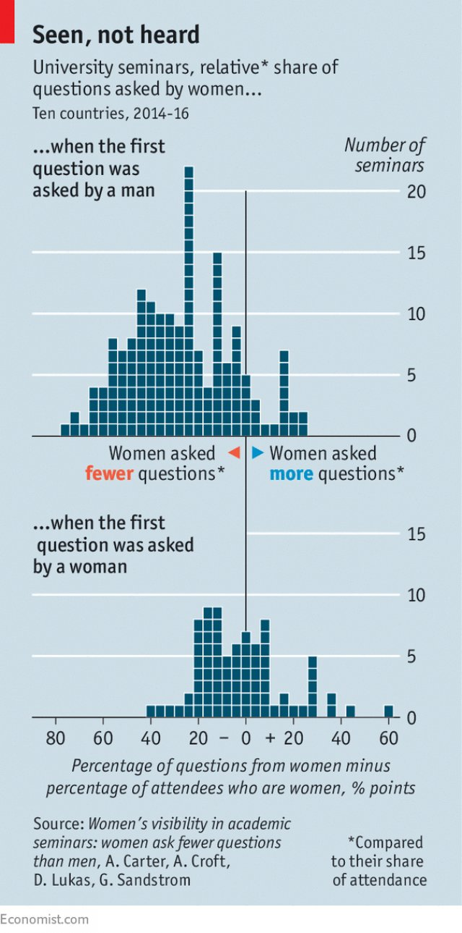
A case study
“ONE theory to explain the low share of women in senior academic jobs is that they have less self-confidence than men. This hypothesis is supported by data in a new working paper, by a team of researchers from five universities in America and Europe. In this study, observers counted the attendees, and the questions they asked, at 249 departmental talks and seminars in biology, psychology and philosophy that took place at 35 universities in ten countries. On average, half of each seminar’s audience was female. Men, however, were over 2.5 times more likely to pose questions to the speakers—an action that may be viewed (rightly or wrongly) as a sign of greater competence.
This male skew in question-asking was observable, however, only in those seminars in which a man asked the first question. When a woman did so, the gender split in question-asking was, on average, proportional to that of the audience. Simply handing the microphone to a woman rather than a man when the floor is opened for questions may make a difference, however small, to one of academia’s most intractable problems.”
The Economist
Print edition | Science and Technology
December 7, 2017
Notes:
see my sexQuestionDemo.m
C:\usr\rick\doc\Committees\PIN\PIN Director\Courses\Stats\TAD Fall 2017\TAD2017\Last class

Slide 4
Pitfalls of black-white thinking
The Difference Between “Significant” and “Not Significant” is not Itself Statistically Significant
40
p = 0.012
mean +/- SEM
30
Are drugs A and B significantly different in their efficacy at decreasing blood pressure?
Mean decrease in BP (MAP in mm Hg)
p = 0.32
20
No!
10
0
p = 0.29
A
B
Drug
“That is, we want to underscore that, surely, God loves the .06 nearly as much as the .05. Can there be any doubt that God views the strength of evidence for or against the null as a fairly continuous function of the magnitude of p?” – Rosnow & Rosenthal 1989
Gelman & Stern (2006) The American Statistician, 60:328-331
Notes:
“Consider two independent studies with effect estimates and standard errors of 25 ± 10 and 10 ± 10. The first study is statistically significant at the 1% level, and the second is not at all statistically significant, being only one standard error away from 0. Thus, it would be tempting to conclude that there is a large difference between the two studies. In fact, however, the difference is not even close to being statistically significant: the estimated difference is 15, with a standard error of √10^2 + 10^2 = 14.”
MATLAB:
p = 2*(1 – normcdf(mu/sem))
Study #1: p = 2*(1 - normcdf(25/10)) = 0.0124
Study #2: p = 2*(1 - normcdf(10/10)) = 0.3173
Study 1 vs. study 2: p = 2*(1 - normcdf(15/sqrt(200))) = 0.2888;
One point to ponder: If you give me ANY two non-identical p-values, I can always find a criterion that will make one significant and the other non-significant.

Slide 5
Pitfalls of black-white thinking
The counternull value of an obtained effect size is that non-null magnitude of effect size that is supported by exactly the same amount of evidence as is the null value of the effect size.
40
mean +/- 95% CI
30
Mean decrease in BP (MAP in mm Hg)
20
10
0
A
Drug
B
Effect sizes and confidence intervals
convey much more information.
Rosenthal & Rubin 1994
Notes:
This practice also helps us to avoid the pitfall of mistaking statistical significance for biological significance.

Slide 6
Mistaking statistical for biological significance
The counternull value of an obtained effect size is that non-null magnitude of effect size that is supported by exactly the same amount of evidence as is the null value of the effect size.
0.4
mean +/- 95% CI
0.3
Mean decrease in BP (MAP in mm Hg)
0.2
0.1
0
A
Drug
B
Would we still care?
Rosenthal & Rubin 1994
Notes:
This practice also helps us to avoid the pitfall of mistaking statistical significance for biological significance.

Slide 7
A case study
“ONE theory to explain the low share of women in senior academic jobs is that they have less self-confidence than men. This hypothesis is supported by data in a new working paper, by a team of researchers from five universities in America and Europe. In this study, observers counted the attendees, and the questions they asked, at 249 departmental talks and seminars in biology, psychology and philosophy that took place at 35 universities in ten countries. On average, half of each seminar’s audience was female. Men, however, were over 2.5 times more likely to pose questions to the speakers—an action that may be viewed (rightly or wrongly) as a sign of greater competence.
This male skew in question-asking was observable, however, only in those seminars in which a man asked the first question. When a woman did so, the gender split in question-asking was, on average, proportional to that of the audience. Simply handing the microphone to a woman rather than a man when the floor is opened for questions may make a difference, however small, to one of academia’s most intractable problems.”
The Economist
Print edition | Science and Technology
December 7, 2017
Notes:
see my sexQuestionDemo.m
C:\usr\rick\doc\Committees\PIN\PIN Director\Courses\Stats\TAD Fall 2017\TAD2017\Last class

Slide 8
Week #2:
Follow-up

Slide 9
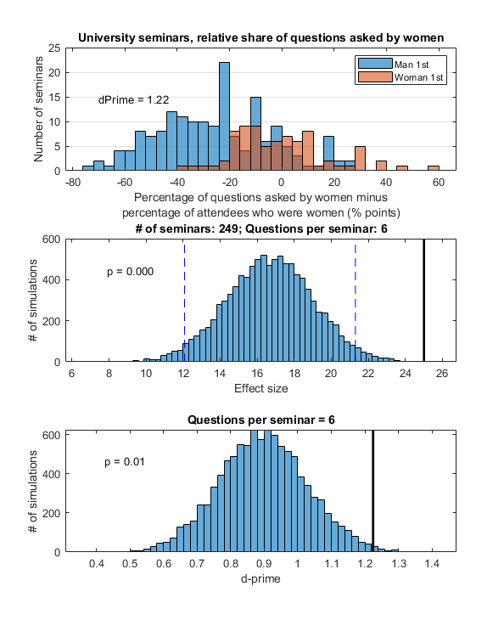
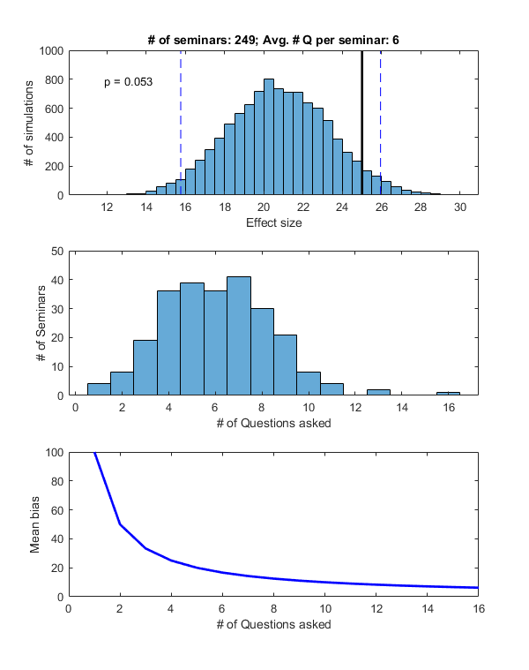
A simulated surprise!
Notes:
I would never have come to these conclusions without having done the simulations! In fact, my intuition going in was that the mean of the simulated bias distribution would be the same whether we assumed that ALL seminars had exactly the same number of questions or whether we assumed that they had the same average number that varied randomly from seminar to seminar.

Slide 10
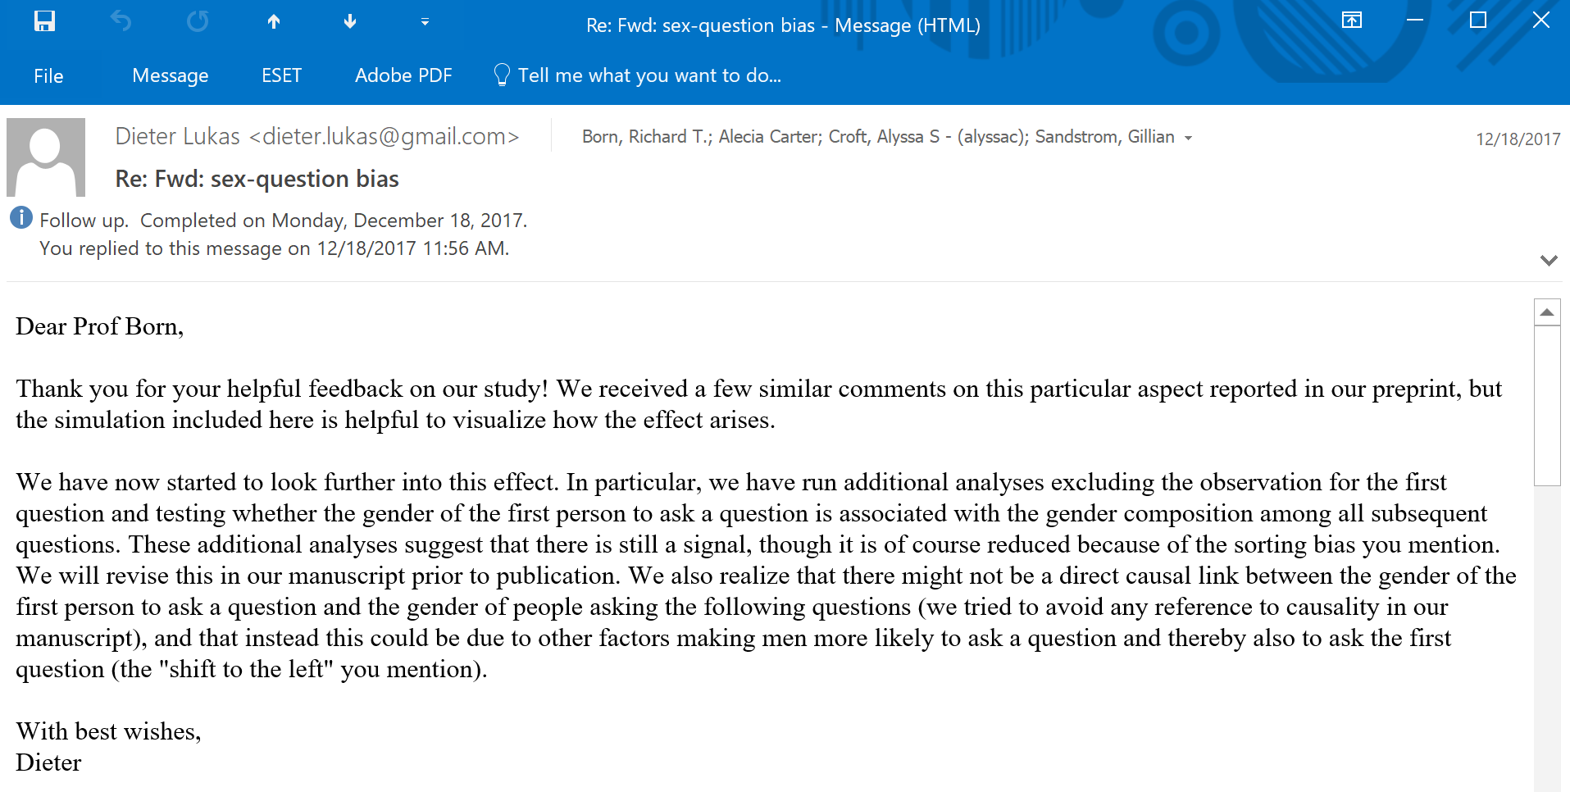
Simulated data; real consequences

